Slide 1



A2Q
Answer Any Question
A Retrieval-Based QA Pipeline for Complex PDFs
37 / 40
questions correct
Group: Matterhorn
Qazi Muhammad Ashhad Abbasi
Neeharika Lalita Vajjhala
Yu-Shuan Su
SDSC x Durham University
Hackathon 2026

Slide 2
Project Aim
Build a question answering system that makes complex documents searchable and accessible to an LLM.
Objectives
Extract information from text and non-text document content.
Make structured and unstructured data searchable.
Retrieve relevant evidence for each question.
Generate answers from the provided documents.
Handle complex content such as tables, charts, images, footnotes, and acronyms.

Slide 3


What we worked with
4
572
40
PDF Reports
Total Pages
Questions
Data types:
· Paragraph text
· Tables
· Charts & graphs
· Images
· Acronyms
· Report appendices

Slide 4
What made this difficult
Long Documents
Mixed Formats
Computably expensive to send all to an LLM.
Text, tables, charts & images each need different handling.
Visual Questions
Rotated Pages
Some answers only exist inside charts and figures.
Rotated visual caused vision model to misread axes.
Acronyms & Terms
Multi Media Answers
BM25 fails when question used abbreviation.
Some questions needed answers to be sourced from text and visuals together.

Slide 5
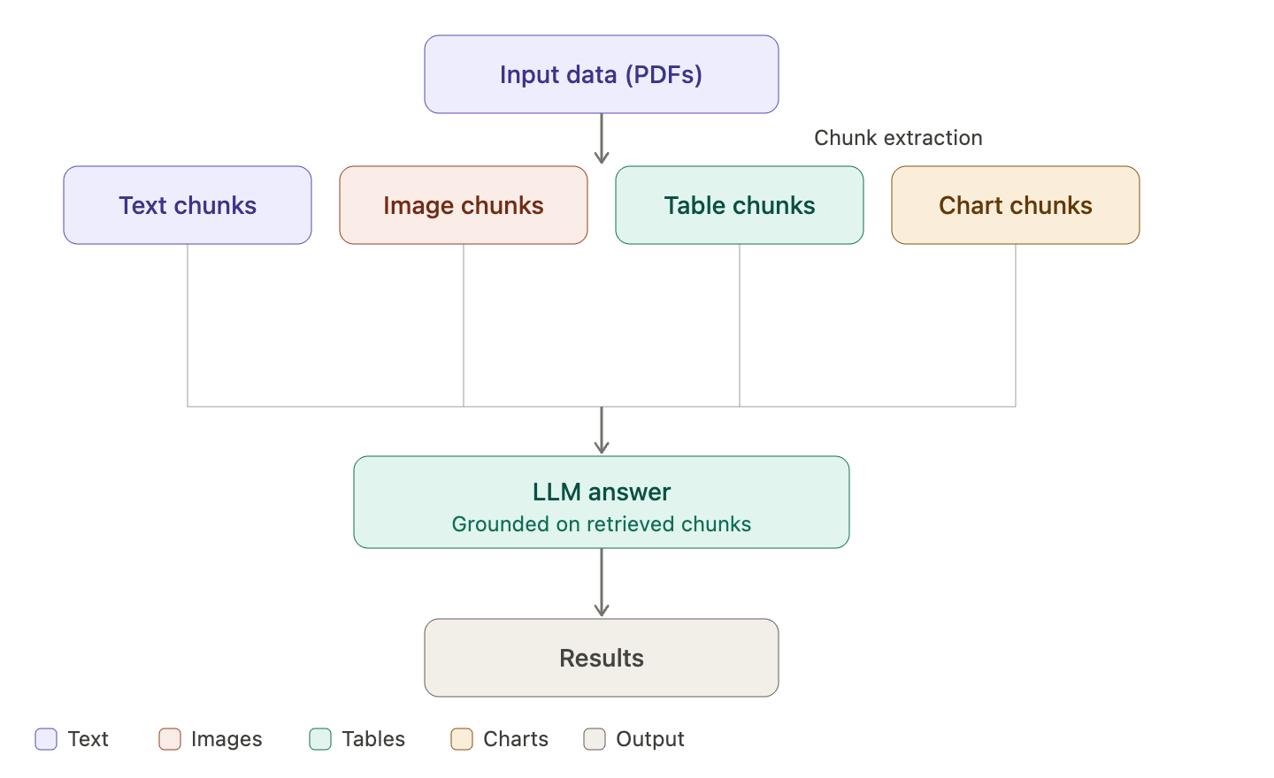

Challenger Approach

Slide 6
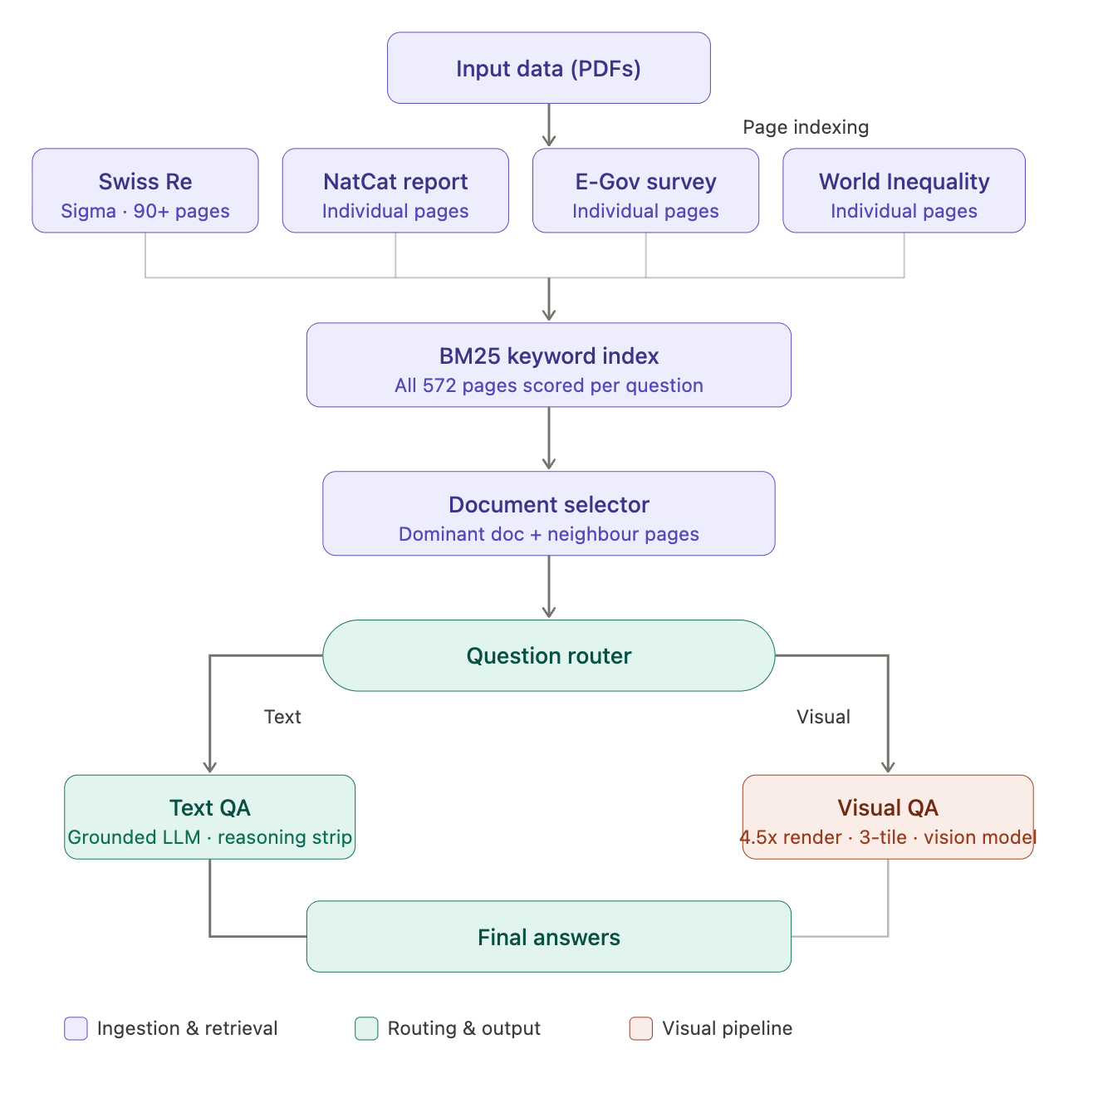
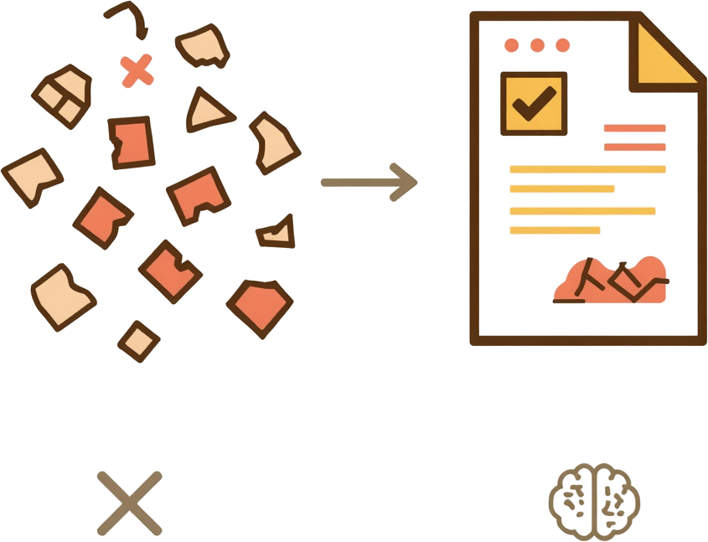
Champion Approach

Slide 7
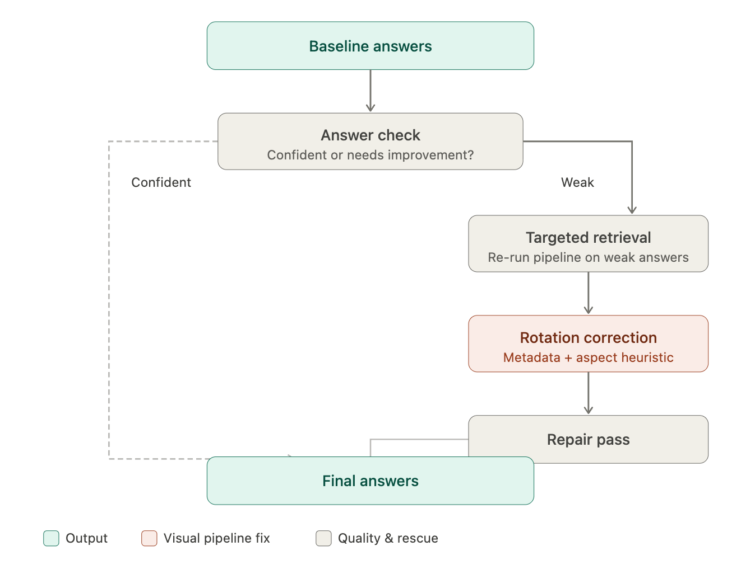
Improvements
Brute Force Approach
+ 15
more questions answered
22 → 37 / 40

Slide 8
If We Had More Time
CNN model to get better image insights for improved visual results
Implementing BERT or LDA for better text understanding and context building

